Slide 1
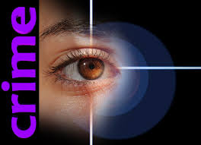
There is a crime
CRIMINAL CASE : JOHN CARLES

Slide 2
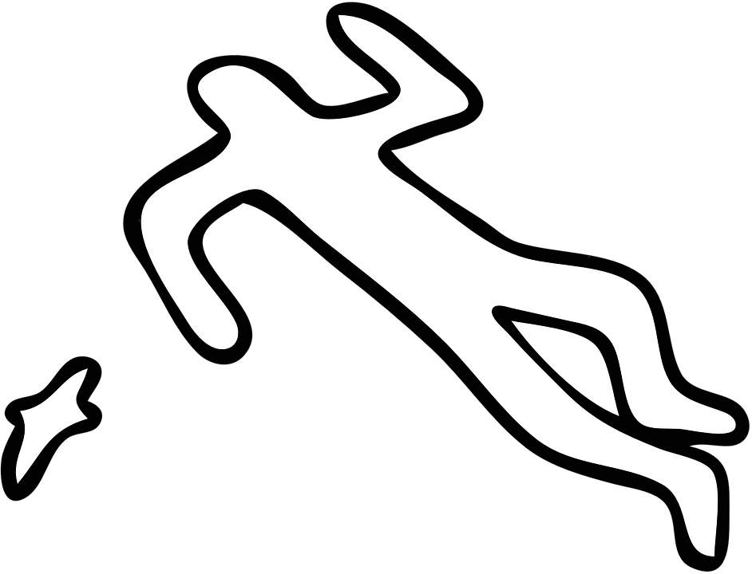
Our director, John Carles, has been found dead in his office. The body was on the floor near the chair where he usually sits.

Slide 3
In the office, a suicide note was found with Professor John's personal pen, but curiously it was written in ink on a felt-tip pen.

Slide 4
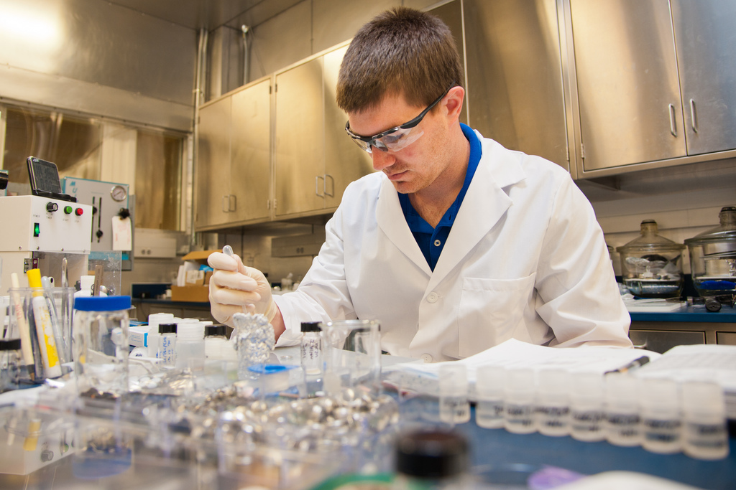
The offices were turned upside down and several drawers were open. It is known that John was about to publish an important discovery that would provoke envy to his colleagues. Fingerprints and drops of blood have been found on the floor in one of the drawers.

Slide 5
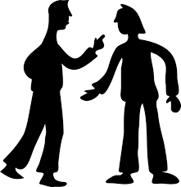
A few hours earlier, the students heard a loud argument in the office. Research documents have been disapeared.

Slide 6
John Carles was a person of delicate health and had many allergies and intolerances, to the salt, certain microorganisms and several foods like the onion. The autopsy has been a heart attack caused by one of these agents.

Slide 7
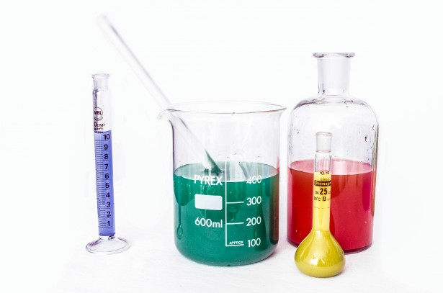
For that reason, crimal resarchers have collected samples of the liquids, a bottle of mineral water and rest of a sandwich.

Slide 8
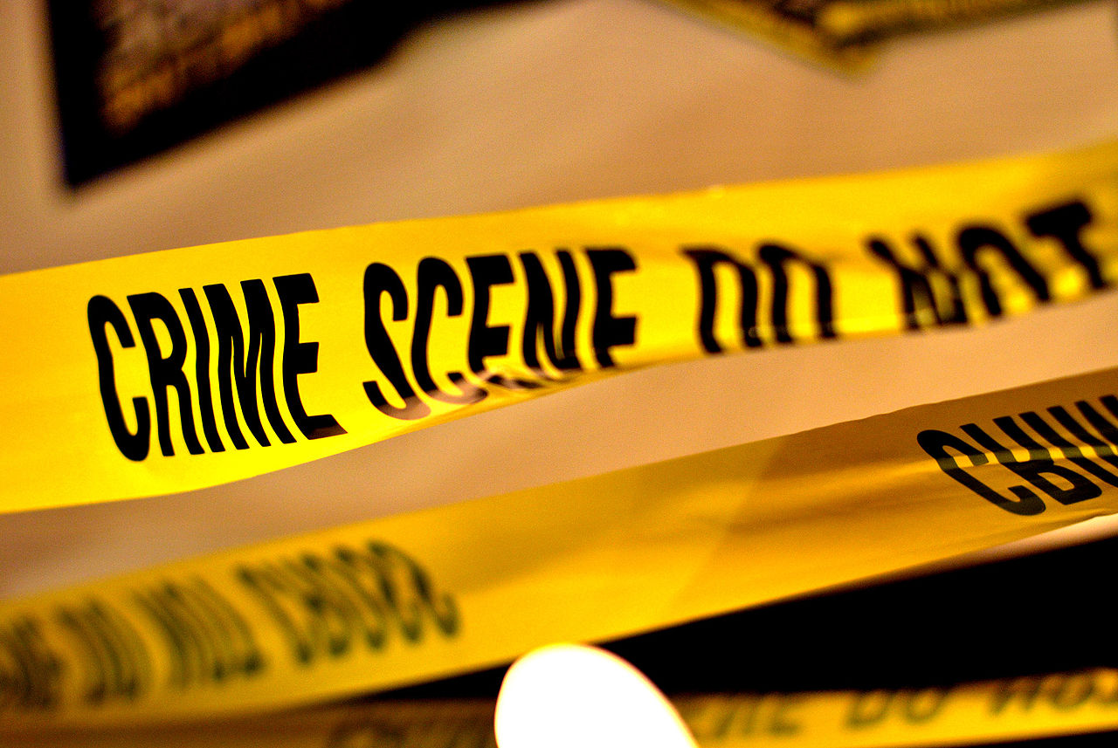
Alhough it looks like a suicide, all evidences have given many indications to suspect that it has been a crime. The police, after several interrogations, have several suspects in mind, but it needs scientific evidence.

Slide 9
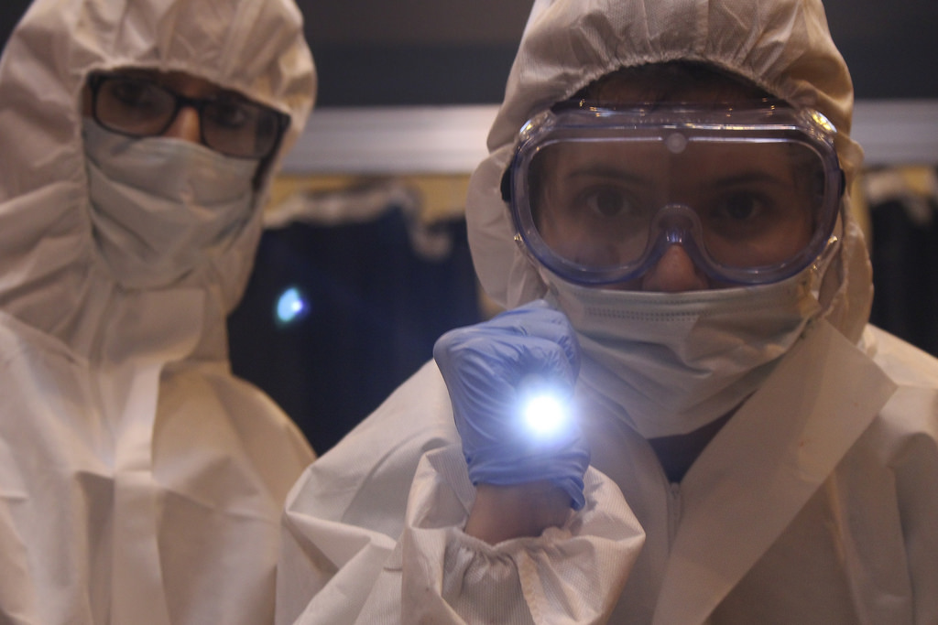
Our job is to analyze the tests in the laboratory, compare them with those found in the offices of the suspects and present a forensic report that we must explain during the trial.

